Slide 1
Gene Expression

Slide 2
Cell Communications
Cells work together in an organism for its survival.
Communicate and send chemical signals
These cell types can’t carry out their functions unless gene expression occurs.

Slide 3
How do cells communicate with other cells? Written Response #22
Why must cells communicate with each other?
Types of Communication within cells:
To maintain homeostasis.
Short distance communication, long distance communication.

Slide 4
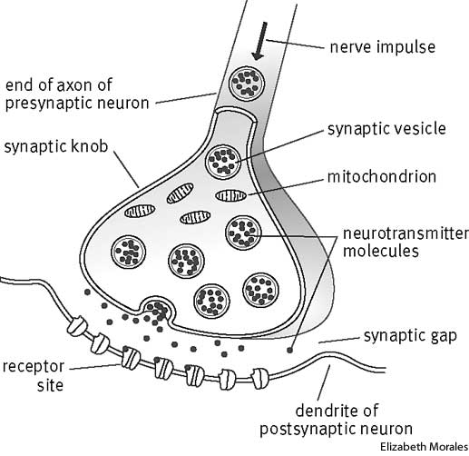
Short Distance Communication
Junctions
Some cells are physically joined together at junctions.
These cells send signals directly to the next cell.
Ex: One heart cell uses an electrical impulse to stimulate neighboring heart cell to contract.
Synapses
Some cells are separated by a very short distance called a synapse (Typically Nerve Cells).
Release a chemical message into the synapse, message received by the other cell using special receptors.
Ex. Pain receptor nerve cell sends message to spinal cord never causing reflex reaction.

Slide 5
Long Distance Communication
Long distance communication uses hormones to send the communication to the desired cell.
Signal must be specifically shaped so that only the target cell will receive the signal.
Written Response #23
How does the cell ensure that the hormone reaches the “target” cell?
How does the body get the hormone to the desired cell?

Slide 6
Steps to Gene Expression
Traits will not appear unless proteins are produced.
Inside the Nucleus
DNA is unable to leave the nucleus so it must make mRNA to send its genetic code out of the nucleus to code for proteins.
All cells in an individual have the same DNA
(Except for red blood cells or gametes in humans.)
Ribosomes
Protein production occurs at the ribosomes.
RNA is decoded to assemble small subunits called amino acids.
Amino acids link up to form proteins.
Proteins are important for: cellular functions, gene expression and structure.
Most cellular task use proteins.

Slide 7
Gene Expression
Gene expression: creating a functional protein from the info in DNA.
Differentiation: cells becoming a specific cell type for a specific function.
Influenced by environment and cell’s history.

Slide 8
Stem Cells
Stem cells: Undifferentiated cells that may become any cell type.
Embryonic stem cells: present in developing fetuses as they grow.
Adult: present in bone marrow.
May continually reproduce to make many different cell types.
Any undifferentiated cell may become differentiated to a specialized cell but the process can’t be reversed.

Slide 9
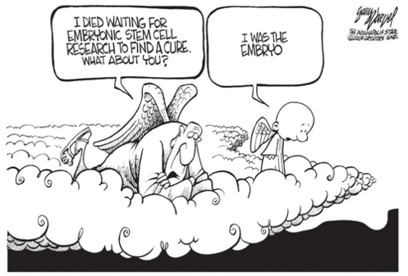
Stem cell research:
Written Response #24
What makes stem cell research controversial?
What can we do to prevent “crossing the line”, what happens if we do cross the line?
Controversial field of research that may allow for important medical advancements; stem cells may differentiate under the right lab conditions.
Advancements in stem cell research.

Slide 10
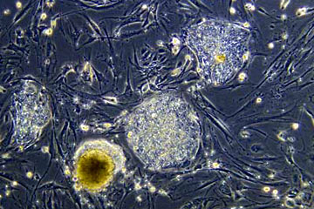
Specialization
Stem Cell – A cell type that is not yet differentiated; may become any differentiated cell type.

Slide 11
Specialization
Nerve Cell – Cell that composes the nervous system (brain, spinal cord, peripheral nerves) and sends electrical and chemical signals that allow for communication and connections to be made (neuron).

Slide 12
Specialization
Muscle Cell – Cell that composes muscles, complete with many mitochondria and myofibrils (made of protein) for contraction (myocyte).

Slide 13
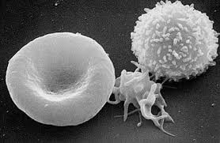
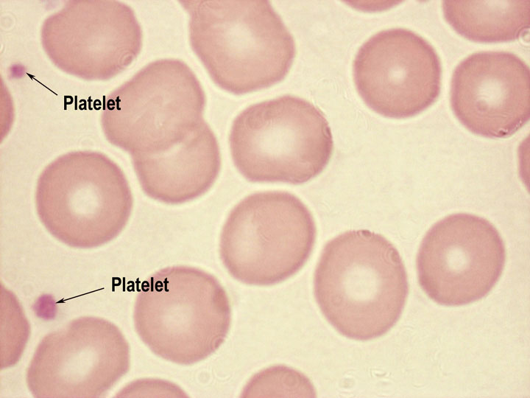
Specialization
Blood Cell – Only cell in the body without a nucleus or DNA
3 types –
red blood cell – carries oxygen by hemoglobin.
white blood cell – role in immunity.
platelets – responsible for clotting.

Slide 14
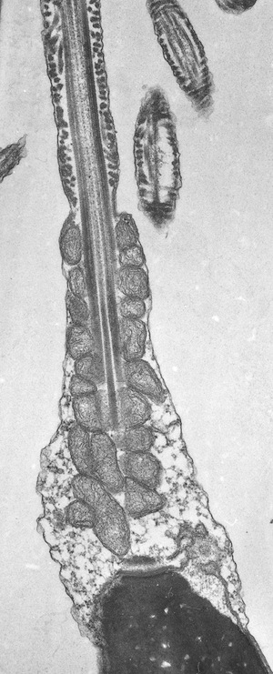
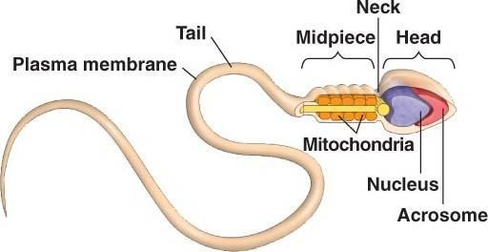
Specialization
Sperm Cell – Male sex cell in many sexually reproducing organisms, complete with flagellum for locomotion and a large number of mitochondria for energy. (Haploid Gamete)

