Slide 1
Unit 5- Dna
5.1 intro to dna

Slide 2
Written response #1
Look up and determine if the following statements are true or false:
Genes are traits.
Some organisms do not have DNA.
Information in the DNA of a plant or animal does not affect behavior.
DNA is made up of amino acids.
Chromosomes are made up of DNA.
Information in DNA affects the physical characteristics of an organism.
The code of DNA is determined by the order of the nucleotides.
There are 20 types of nucleotides.
Different cell types in an organism have different DNA.
Proteins are made up of DNA.

Slide 3
Written response #1 Answers
Genes are traits.
False. Genes determine traits and traits are what we see.
Some organisms do not have DNA.
False. All “living organisms” contain DNA
Information in the DNA of a plant or animal does not affect behavior.
False. Innate (natural) behavior is controlled by genetics and is passed to offspring. Ex: birds nesting
DNA is made up of amino acids.
False. DNA is made up of 5-carbon sugar, phosphate group and nitrogen base.
Chromosomes are made up of DNA.
True

Slide 4
Written response #1 Answers
Information in DNA affects the physical characteristics of an organism.
True
The code of DNA is determined by the order of the nucleotides.
True
There are 20 types of nucleotides.
False. Amino acids
Different cell types in an organism have different DNA.
False. Location of DNA is different (nucleus or cytoplasm)
Proteins are made up of DNA.
False. DNA determines protein.

Slide 5
What is DNA?

Slide 6
What is DNA?
What does DNA stand for?
Deoxyribonucleic Acid
RNA or Ribonucleic acid is the other genetic material in the cell.
What is the function?
Store and transmits heredity.
Heredity - the passing of traits from parent to offspring.
What's the purpose?
DNA is the blue print for life--- it codes for all protein which give us traits.
Provides the material that leads to protein synthesis also known as The Central Dogma of Molecular Biology

Slide 7
Importance of DNA
4. Where is it located?
Eukaryotes- Nucleus
Prokaryotes- Free floating in the cell cytoplasm
How is it packaged?
Chromosomes- each chromosome is a continuous double helical DNA molecule
Why do chromosomes look different than the chromatin form?
Chromatin is loosely packed DNA whereas chromosomes are DNA wrapped around protein and tightly packed together. (Supercoiled)

Slide 8
Introduction to DNA
Written Response #2: How do you think traits are passed?
Scientist determined that chromosomes controlled heredity and are made of DNA and proteins.
DNA is the molecule that controls characteristics (traits).
Written Response # 3: How are the chromosomes different in eukaryotes and prokaryotes
Prokaryotes- DNA is in the form of a singular circular chromosome known as a plasmid that free floats in the cytoplasm
Eukaryotes- DNA is in the form of homologous chromosomes that are located inside the nucleus
.

Slide 9
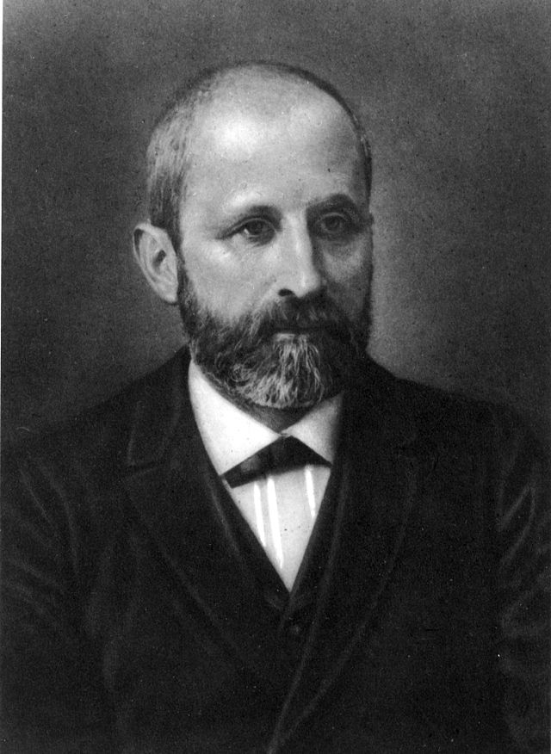
History of DNA
1869- structure of DNA molecule first described
Frederick Miesher- Identifies “Nuclein” in white blood cells of humans
What we know now as DNA

Slide 10
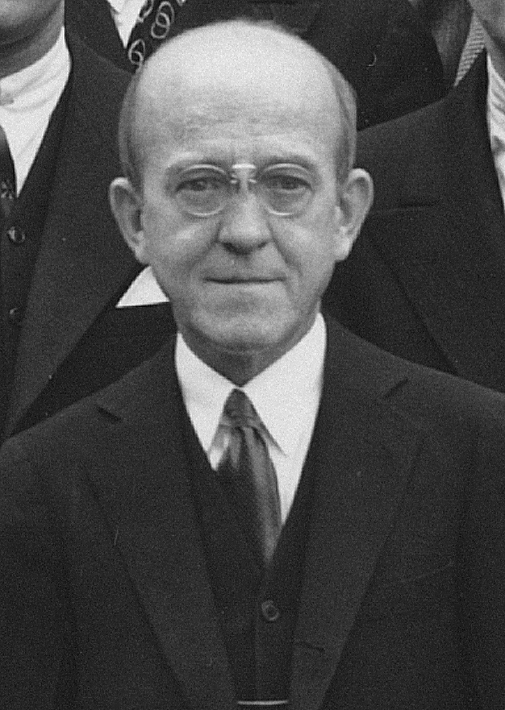
History of Dna
1944- DNA identified as the “transforming principle”
Oswald Avery- immunochemist that worked with bacteria and pneumococcus- revealed that DNA was a nucleic acid—and when altered it could be deadly

Slide 11
History of DNA
1950- DNA is species specific
Erwin Chargaff is famous for two things
1. DNA varies between different species
2. A=T & G=C

Slide 12
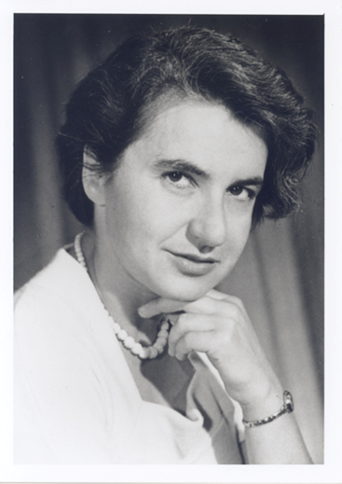
History of DNA
1952- Photographs of crystallized DNA
-Rosalind Franklin and Frances Wilkins
Studied DNA using x-ray diffraction
Investigated the shape and structure of DNA
Photo 51: x-ray image that showed the shape of the DNA molecule

Slide 13
Photo 51
X-ray diffraction image of DNA
1952: Maurice Wilkins showed the picture of Photo 51 to James Watson without Franklin’s approval or knowledge.

Slide 14
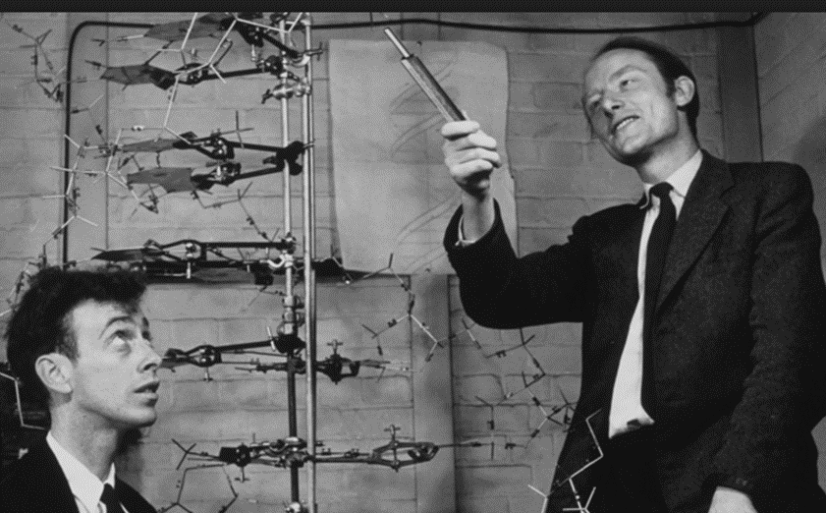
History of DNA
1953- DNA double helical structure established
Watson and Crick were credited with the discovery of DNA after viewing photo 51 without Franklin’s approval

Slide 15
HAVE Your DNA and EAT it Too - Activity
Complete the activity.
Raise your hand when you have completed the activity and I will come check you off for completion.
Glue/tape the worksheet into your notebook making sure the stamp is visible.

Slide 16
Root Words 5/5
5 minutes to study quietly

Slide 17
Intro to DNA
DNA and Life:
All living things have DNA. Even some non-living things (viruses)
DNA condenses into chromosomes just before cell division
Creates packages of genetic material (containing certain genes)
Normal humans have 46 total chromosomes
Give the detailed information about all of our traits

Slide 18
Intro to dna
Written Response #3: Draw and label a nucleotide.
That information is given through a series of nucleotides that compose the molecule
Nucleotides are monomers that make up DNA and RNA:
Consist of 3 parts:
5-Carbon Sugar
Phosphate group
Nitrogen base

Slide 20
Written Response #4: Do all of your cells have the same dna? Explain your answer.
DNA is needed in each cell to make necessary proteins
Because DNA is so important, when a cell divides, it must pass on an exact copy of the DNA to function correctly.
Therefore, DNA is copied (replicated) during the S phase of the cell cycle (part of interphase before mitosis/meiosis).
Notes:
Yes and no. It is the same genetic code but is a copy

Slide 21
Intro to DNA
DNA Replication
The DNA molecule’s most crucial task is to provide the information necessary to lead to the production of proteins
Must make EXACT copies!
Why? All cells need the same copy of DNA when they divide
This process is called DNA replication-happens during S phase

Slide 22
Intro to dna
Steps of DNA Replication:
Unzipping – Enzymes (DNA helicase) break apart the weak hydrogen bonds that hold the bases together in the middle of the strand
New nucleotides are added to each side of the original strand by the base pairing rule (this happens in the middle of the unzipped strand)
Process continues until 2 molecules of DNA are formed
Each has 1 original DNA strand and 1 new strand
Called semi-conservative replication
Some old DNA and some new DNA

Slide 23
Written Response #5: Draw and label a diagram for each of the three steps of DNA replication.

Slide 25
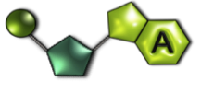
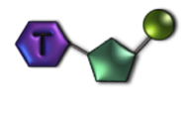
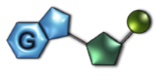
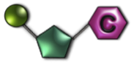
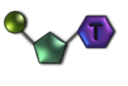
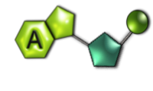
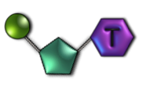
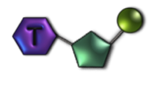
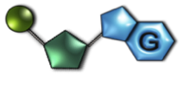
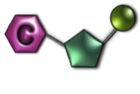
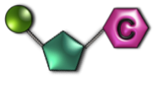
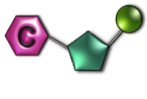

Slide 26
Making a Model of DNA Activity
Color your nitrogen bases, phosphate groups and deoxyribose sugars first.
Cut out each structure.
Using the symbols, line up the bases, phosphates and sugars.
Construct one side of your DNA molecule by using the sequence: cytosine, thymine, guanine and adenine.
Construct the complementary side of your DNA.

