Slide 1
Mutations
5.4

Slide 2
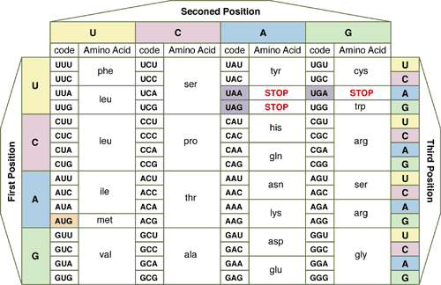

Slide 3
Written Response #13
What controls inherited traits?
What controls the production of proteins?
Define a gene.
Diagram the central dogma of biology.
What is the purpose of transcription?
What type of RNA is used in transcription?
What nitrogen base in RNA is used as a substitution for thymine?
What is the purpose of translation?
What two types of RNA are used only in translation?
What type of bond links amino acids?

Slide 4
Mutations
Mutation: Any change in a sequence of DNA that occurs spontaneously
Changes the protein coded by that gene
When a protein changes, the function changes and may:
Continue to function normally
Not function as well
Cause a benefit or contribute to evolution
Result in death
Only mutations in sex cells can result in heritable changes

Slide 5
Mutations
Beneficial mutations: mutations that have a positive effect on the organism.
Ex: Mutations in bacteria that allow them to survive in the presence of antibiotics
Harmful mutations: change in gene’s DNA that causes the protein to not function normally or not function at all.
Ex: Cystic fibrosis is when the body produces a thick, sticky mucus that clogs the lungs and blacks ducts in digestive organs

Slide 6
Mutations
Mutagens: Any substance which causes a mutation by altering a cell’s DNA
Cigarettes, asbestos, UV-rays, X-rays
Carcinogens are often harmful or deadly

Slide 7
Mutations
Types of Mutations:
Germline mutations
Occur in gamete (sex) cells
Can be transmitted to offspring and every cell in offspring will have the mutation.
Somatic mutations
Occur in body cells
Have little effect on organism due to being confined to one cell and its daughter cells

Slide 8
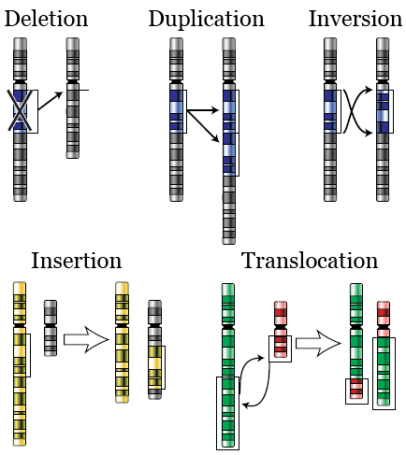
Mutations

Slide 9
Mutations
Point Mutation
How it occurs: A change in a single nucleotide in a segment of DNA
What it causes:
Normal: TACCCGTAA
Mutated: TACCCTTAA
Examples: Sickle Cell Anemia – change in hemoglobin protein

Slide 10
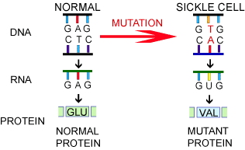
Mutations

Slide 11
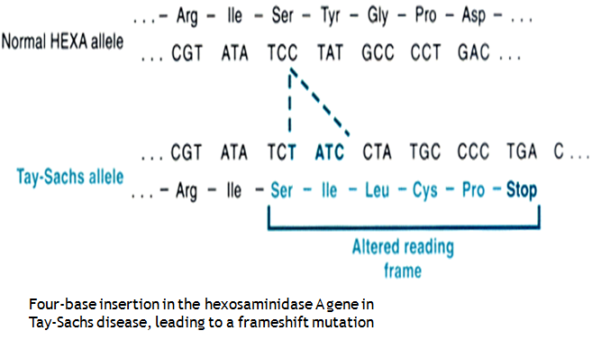
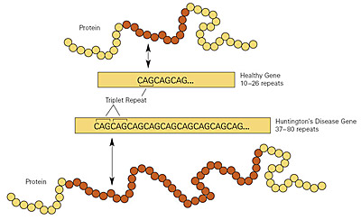
Mutations
Frameshift (addition or deletion)
How it occurs: Nucleotides are added (insertion) or deleted (deletion)
What it causes:
TAGCCGTAA
TAGTAA
Examples:
Tay Sachs Disease – neurological disease found in children
Huntington’s Disease – neurological disease found in adults

Slide 12
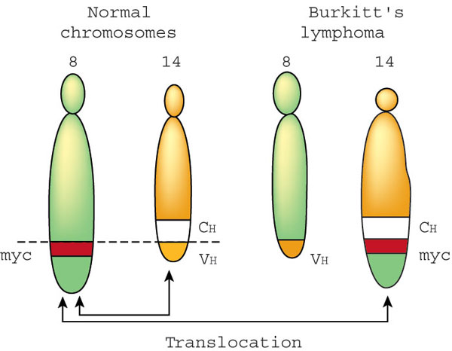
Mutations
Translocation
How it occurs: Transferring a whole segment of a chromosome to another
What it causes: Chromosomes change in structure or size
Examples: Burkitt’s Lymphoma – cancer of the lymphatic system

Slide 13
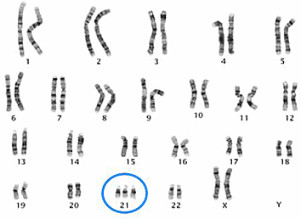
Mutations
Chromosomal Mutation
How it occurs: Altering the shape or number of a chromosome (nondisjunction)
What it causes: May have one too many or one too few chromosomes in a pair
Examples:
Down Syndrome (21st chromosome trisomy)
Klinefelter’s Syndrome (XXY)

Slide 14
Written Response #14
Define mutation.
What is the result of a mutation?
What are the two types of mutation?
Which type of mutation may affect a greater number of amino acids?

Slide 15
Mutations Practice - handout
This will be homework or given at the end of class.

Slide 16
What are the Effects of Various Mutations on Protein Synthesis? - handout

