Slide 1
Human Genetics
The presence of every trait or characteristic that you possess depends on the properties of the genes you inherited from each parent
There are two types of traits: dominant and recessive

Slide 2
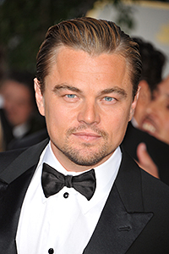
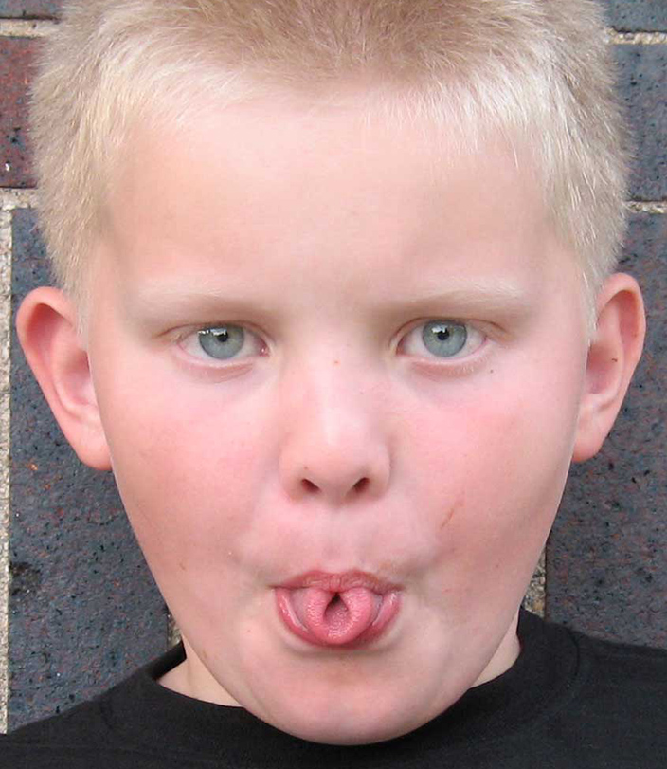
Human Genetics
Dominant traits: appear over a recessive form and are often more prevalent but not always
Examples: freckles, bent pinkie, tongue rolling, left hand over right hand (when folding hands), widow’s peak, fused fingers
Examples of dominant traits seen less often: Huntington’s disease, dwarfism

Slide 3
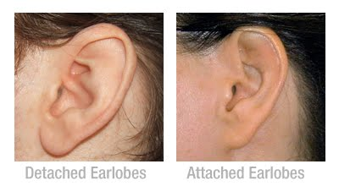
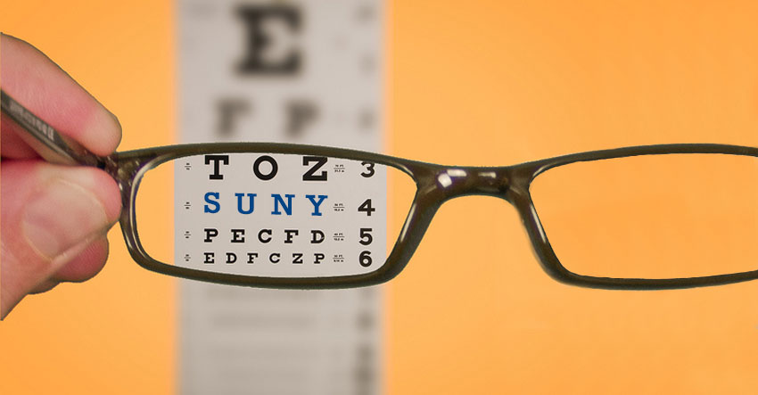
Human Genetics
Recessive Traits: masked when a dominant trait is present so are less likely to be observed.
Only appear when there are NO dominant traits.
Examples: albinism, red hair, attached earlobes, allergy to poison ivy, nearsightedness, no tongue rolling

Slide 4
Human Genetics
Genes play a large role in the presence of debilitating disorders
Many genetic disorders are simply dominant or recessive and are associated with genes located on any of the autosomal chromosomes
44 non-sex chromosomes
Others are associated specifically with the sex chromosomes

Slide 5
Human Genetics
Recessive Disorders:
Caused by the presence of two recessive alleles
Examples: Cystic Fibrosis, PKU

Slide 6
Human Genetics
Dominant Disorders:
Caused by the presence of one or two dominant alleles
Examples: Huntington’s Disease, Dwarfism, Neurofibromatosis

Slide 7
Human Genetics
Sex-Linked disorders:
Caused by alleles located on the X chromosome
Examples: Hemophilia, Color-blindness, Male-patterned baldness

Slide 8
Human Genetics
Co-Dominant Disorders:
Caused by two alleles that both show up in true form
Example: Sickle Cell Anemia

Slide 9
Human Genetics
Nondisjunction Disorders:
Caused by the failure of chromosomes to separate during meiosis
Examples: Down Syndrome, Trisomy X, Klinefelter’s Syndrome, Turner Syndrome, XYY Syndrome

Slide 14
Alien Life Form Project
Complete Parts 1 and 2.
When you have completed parts 1 and 2 raised your hand so I can check you off.
DO NOT lose parts 1 and 2. You will be responsible for having these parts later in the project.

