Slide 1
Complete Station Race Assignment…
Turn in once your group has completed the assignment.

Slide 2
How Can You Study Human Heredity?
Population sampling determines how often a trait appears in a small, randomly selected group.
This percentage is then applied to the entire population to predict the number of individuals with that trait.
Pedigrees graphically record the inheritance of a single trait over several generations.
The occurrence of the trait is determined based on family/historical documents, interviews, photographs and medical records.

Slide 3
Pedigrees
Pedigree: graphic representation of traits passed through generations.
Shows genetic history
A line on a pedigree represents relationships within the family between individuals
A half-shaded circle or square will represent a carrier for the disease
Individual | With Trait | Without Trait
Female
Male

Slide 4
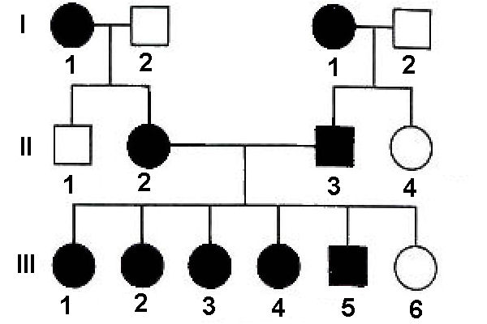
How Can I Tell What Type of Trait the Pedigree is Showing?
A dominant trait is likely to be present in every generation

Slide 5
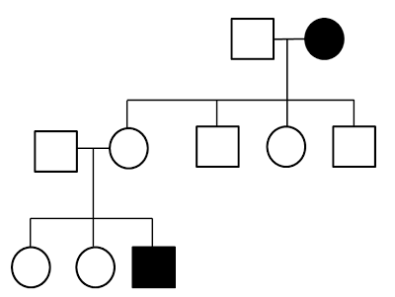
How Can I Tell What Type of Trait the Pedigree is Showing?
A recessive trait may skip a generation

Slide 6
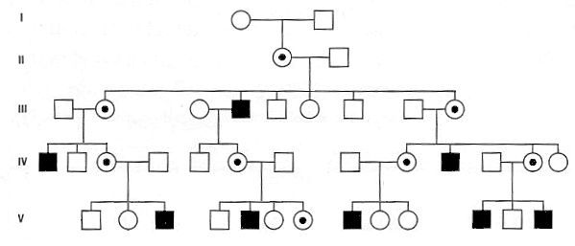
How Can I Tell What Type of Trait the Pedigree is Showing?
A sex-linked trait is most often seen in males

Slide 7
Pedigree Practice - Handout
Complete the handout.
When you have completed the handout, raise your hand and I will check you off.
Glue / Tape the handout into your notebook so the stamp is visible.

Slide 8
Can We Tell if a Baby Has a Genetic Disease?
A genetic counselor can help prospective parents determine the likelihood of passing some harmful genetic traits to their offspring and may suggest further testing procedures.
Counselors may also interpret diagnostic procedures done by the doctor for parents.
Sonograms / ultrasounds use sound waves to produce an image of the developing fetus. This may be used to detect physical abnormalities (such as cleft palate).
Blood tests of the pregnant mother may screen for certain proteins to assess the risk level of certain genetic disorders.
Amniocentesis removes amniotic fluid containing fetal cells. The cells are then cultured until mitosis occurs and the chromosomes are visible.
A karyotype is made using the visible chromosomes. This allows doctors to detect chromosomal abnormalities and the sex of the child but does NOT detect gene abnormalities because the gene sequence is molecular, and not visible.
Chorionic villi sampling (CVS) removes actual tissues from the placenta (made of embryonic cells) in order to create a karyotype. This may be done earlier in the pregnancy, but is far more invasive and riskier.

Slide 9
Can We Tell if a Baby Has a Genetic Disease?
Human genome project has allowed science to develop certain genetic markers. It can detect the presence of certain gene variations on the chromosome.
These genes may either be a direct cause of a disorder or may simply indicate a predisposition for a trait.
Doctors or genetic counselors can use these markers to screen patients and determine if they may be carriers.

Slide 10
Can You Prevent and/or Treat Genetic Disorders?
Currently, there is no “cure” for genetic disorders because the disorder stems from your DNA.
However, the symptoms of genetic disorders can be treated through experimental trials for replacing defective genes.
Gene therapies are being developed using information from the Human Genome Project.
These therapies seek to use engineered cell invaders (i.e. a virus) in order to actually replace the defective gene in target cells with a functioning gene.

Slide 11
Can You Prevent and/or Treat Genetic Disorders?
Environmental factors may play a large role in the expression or progression of certain genetic problems. Environmental factors that interact with genes can be controlled to help prevent the eventual expression of known genetic predispositions.
Appropriate diet can stop the progression of PKU.
Diet may also limit the risk for genetic predispositions such as heart disease, alcoholism and certain cancers.
Environmental toxins such as UV radiation and tobacco products can directly change our genes. Harmful behaviors (such as smoking) and positive behaviors (such as using sunscreen) increase or reduce the likelihood of genetic mutations from these toxins.
The mutations may lead to cancer if protective genes are disrupted.

Slide 12
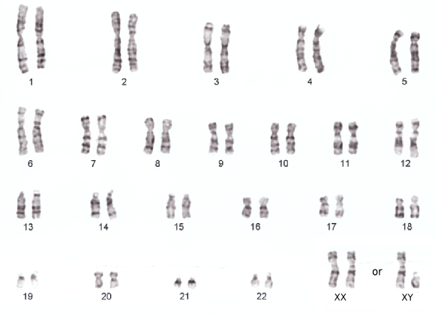
Karyotypes
Karyotypes: pictures of the ordered pairs of chromosomes in an organism
A normal human karyotype contains 23 sets of chromosomes
Can be used to detect disorders caused by nondisjunction

Slide 13
Karyotypes
They are made by arranging the chromosomes formed just before cell division in their homologous pairs
Once copy of each pair is from the mother, the other from the father

Slide 14
Karyotype Stations - Handout
Complete the handout.
When you have completed the handout, raise your hand and I will check you off.
Glue / Tape the handout into your notebook so the stamp is visible.

