Slide 1
Unit 4 Cell Processes
4.3 Cell Cycle

Slide 2
Why are cells so small?
**Cells must stay small to transport materials effectively**
Volume (V) is the amount of space inside of a cell.
This includes the organelles and cytoplasm.
Surface Area is the total amount of exterior which is exposed to the environment around the cell.
This would include the outside of the cell membrane.
Volume increases faster than surface area.
The cell prefers more surface area compared to volume to ensure material moves into the cell and out of the cell quickly enough to meet the cells needs.
Larger SA/V ratio is BETTER….but how is it increased?

Slide 3
How to increase Sa/V
1. Divide (Mitosis) to become smaller
2. Increase Surface Area– grooves in cell membrane
example: villi in small intestine cells—ridges increase SA to transport more efficiently

Slide 4
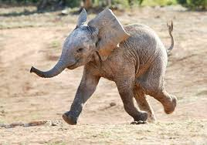
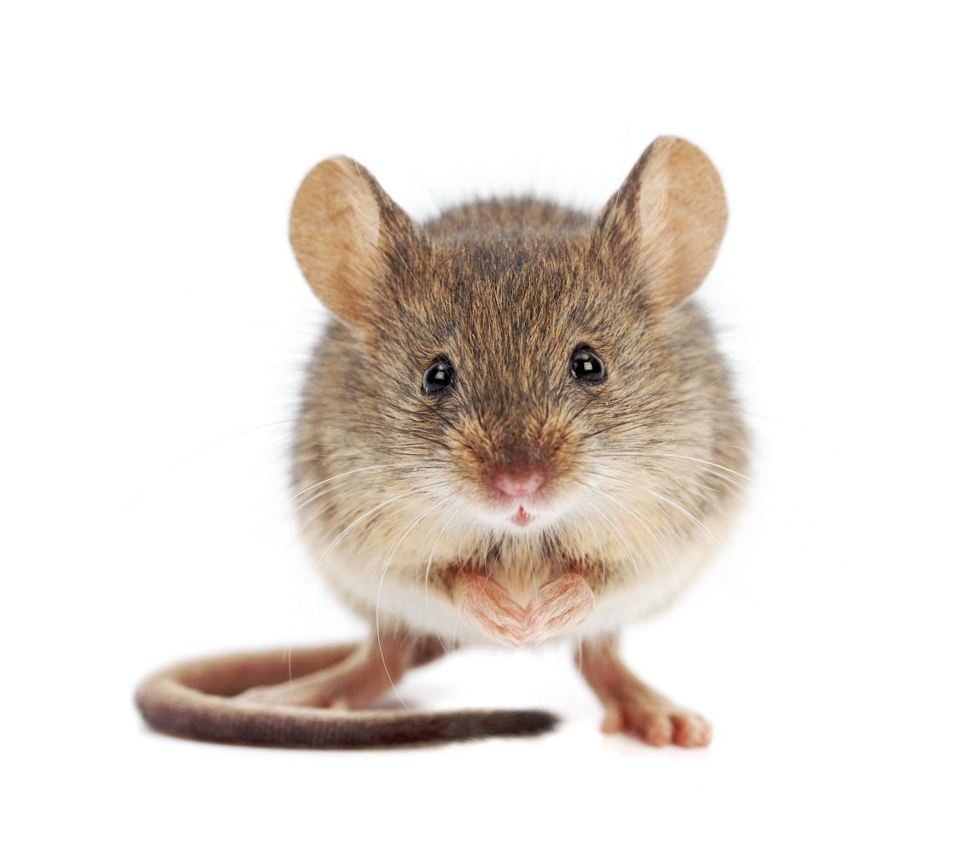
Cells divide to make more cells.
Our cells are the same size!
Do larger organisms such as elephants have larger cells compared to a smaller organism such as a mouse?

Slide 5
Why does a cell divide?
Reproduction- asexual
single celled organism
2. Growth
multi-cellular organisms-don’t get bigger—just have more cells
3. Repair & Renewal
replace cells that die, naturally or by injury
Cell division occurs at different rates depending on the organism and the type of cell.
Plant root cells would divide more rapidly because this is an area of active growth.
Some nerve cells enter a phase of no division.
Some bacteria cells divide very rapidly.
Ex. E. coli can divide every 20 minutes in ideal conditions

Slide 6
How do cells divide?
The result of all cell division is the production of daughter cells.
What must happen to ensure the daughter cells contain enough DNA?
The genetic material of the parent must be copied.

Slide 7
Why do you think Eukaryotic cell division is more complicated than Prokaryotic Cells?
Prokaryotic Cell Division
Eukaryotic division
Prokaryotic cells do not contain a nucleus or membrane organelles so the cell can just evenly divide.
Requires the replication of the nucleus and genetic material.
Also must allocate the organelles into each daughter cell.

Slide 8
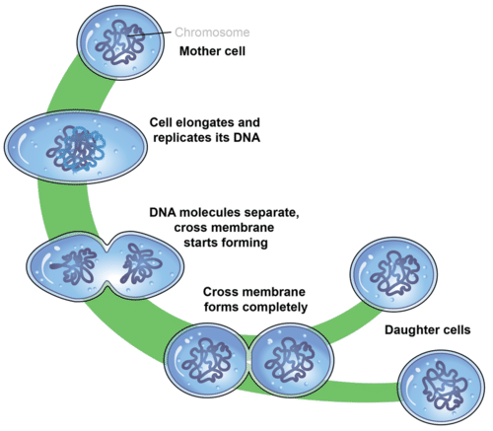
Prokaryotic Cell Division
Binary Fission – The splitting of one cell into two cells.

Slide 9
Cell Cycle Diagram Color and Glue in-Outline what happens in each phase in your NB Outline In green-Interphase G1-Blue S-Pink G2-Purple Mitosis-Divide into phases PMAt-Orange Cytokinesis-Yellow Inside Half circle-Red for Cell Division

Slide 10
Unit 4 Transport Quiz
Please be in your seat—sitting quietly & we will review together!

Slide 11
The Cell Cycle
Essential Ideas:
Cell Division is essential for the cells but must be CONTROLLED
Must occur to replace old cells or make new cells for growth
Can take 10 to 24 hours to complete the full cycle
The cell cycle includes:
Interphase – growth and repair
Mitosis – division of the nucleus
Cytokinesis – final division of the cytoplasm

Slide 12
The Cell Cycle
Interphase:
Essential for growth of the cell
Longest phase of the cell cycle
The cell spends up to 90% of the cell cycle in this phase

Slide 13
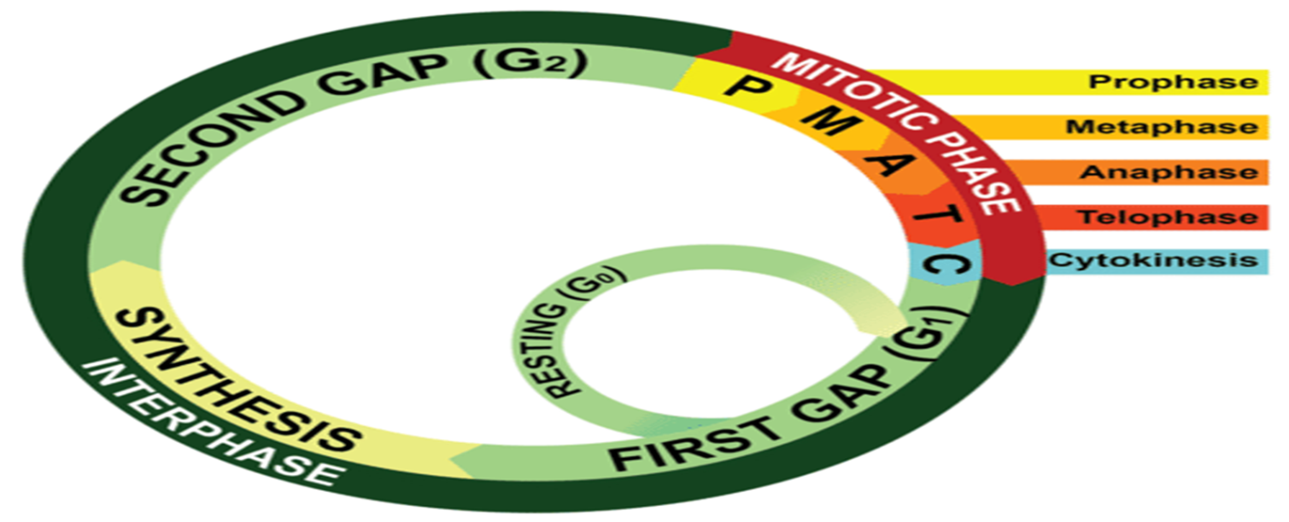
Interphase
Interphase includes 3 major stages:
1. G1 – 1st Gap Phase
The cell doubles in size and synthesizes new proteins and organelles.
What does the term synthesize mean in biology?
To put together or build up.
You are here!

Slide 14
Interphase
2. Synthesis Phase
DNA replicates (synthesizes new DNA)
During most of interphase DNA is in a “relaxed” stage called chromatin.
Chromosomes condense for division so all DNA is packed.

Slide 15
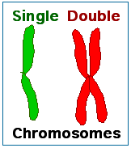
Interphase – Synthesis Continued
Each copy of DNA is called a chromatid.
Two chromatids are attached in a region called the centromere to form a structure called a doubled chromosome.
Chromatids are coiled/condensed.

Slide 16
Interphase
3. G2 – 2nd Gap Phase
More Growth--Final preparations, structures need for division are assembled/begin development (Centrioles, spindles, and centromeres.)

Slide 17
The Cell Cycle
After interphase occurs, the nucleus must divide before the cell can complete the cycle
Mitosis includes 4 distinct phases: prophase, metaphase, anaphase, telophase
Mitosis is followed by cytokinesis, which finalizes the cell cycle and redistributes cytoplasm and organelles

Slide 18
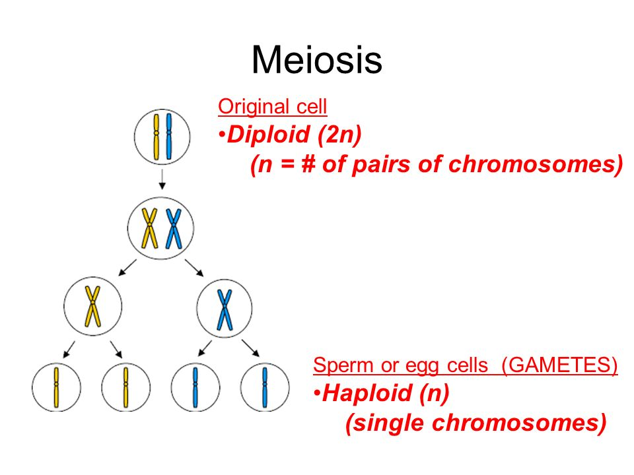
The Cell Cycle
Important terms:
Diploid: Pairs of homologous chromosomes in a cell (1 from each parent) (2n) (somatic cells)
Haploid: Only 1 copy of a chromosome on each pair (gametes) (n)
This diagram will not be discussed this unit—it is only important for you to see the difference between Diploid and Haploid! You will see haploid cells in Unit 6.

Slide 19
The Cell Cycle
Diploid # on this example: ALL
Begins with 1 cell
Ends with 2 cells
Genetically identical
Diploid (2 homoglous chromosomes per pair)
Body (somatic) cells

Slide 20
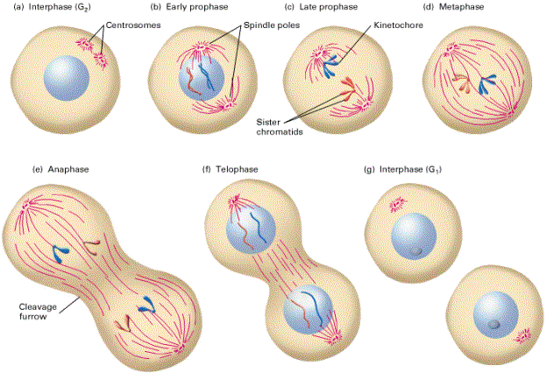
The Cell Cycle
Phases of the cell cycle:
Interphase
Prophase
Metaphase
Anaphase
Telophase
Cytokinesis

Slide 21
What happens when the cell cycle goes wrong?
Amoeba Sisters

Slide 22
Mitosis and Cancer
1. Typically, cell division is controlled by genes in the cell, contact with other cells, and available nutrients in the environment.
2. Cancer is a class of diseases characterized by uncontrolled cell division and the ability of these cells to invade other tissues.
3. Cancer occurs when the genes that control cell division do not function properly.
This may occur because of an inherited genetic defect.
Spontaneous genetic mutation.
Mutation caused by environmental factors.

Slide 23
Written Response #5
Rihanna first noticed a growth on the back of her neck. At first she just thought it was a pimple. It didn’t hurt so she ignored it. After a few weeks it did not heal and she became a little worried. She ignored it for another week and then realized that it began to bleed, then scab, and then bleed again. Finally, her mother looked at the sore and noticed that there was a new freckle that had never been there before.
Rihanna is 23 years old. She tries to eat very healthy. She follows a strict diet and drinks 8 cups of water a day. Rihanna does not smoke nor does she drink. Rihanna is tennis player. She has been playing tennis outside since the age of 6. Over the past 17 years, she has been severely burnt a number of times. The areas of her body that have been burnt that worst are her arms, her face and the back of her neck.
After a skin biopsy (a special test) of the affected area, you confirm that Rihanna has skin cancer on her neck. Cancer can occur on almost area of the skin, but is most common on areas often exposed to the sun.
In your own words describe the cell cycle in a normal somatic (body) cell. You must use the following words: mitosis, G1, G2, S, cytokinesis.
What has gone wrong in Rihanna’s skin cells? Describe how the cell cycle is different in these cells! What stage do you think has been affected most? Why?!

Slide 24
Cell Cycle Review
Name three reasons cells must divide.
Growth of multicellular organisms.
Repair of damaged cells.

Slide 25
Cell Cycle Review
Why is a large surface area to volume ratio preferable?
It allows the cell to carry out its processes more easily.

Slide 26
Cell Cycle Review
Name the cell part below.
Chromatid

Slide 27
Cell Cycle Review
Why is eukaryotic cell division more complex than prokaryotic cell division?

Slide 28
Cell Cycle Review
What are the two basic stages of the cell cycle?

Slide 29
Cell Cycle Review
How is the genetic material “prepared” for cell division during interphase?

Slide 30
Cell Cycle Review
Name the cell part below.
Centromere

Slide 31
Cell Cycle Review
Location where two chromatids are attached.
Centromere

Slide 32
Cell Cycle Review
In this stage of the DNA is replicated.
S-Phase or Synthesis Phase

Slide 33
Cell Cycle Review
Sister Chromatids
Or
Doubled Chromosome
Name the cell part below.

Slide 34
Cell Cycle Review
After cell division has occurred it produces these types of cells.
Daughter Cells

Slide 35
Cell Cycle Review
The part of the cell cycle that the cell spends the majority of its life?
Interphase

Slide 36
Cell Cycle Review
In this stage the cell increases in size and synthesizes new proteins and organelles.
G1

