Slide 1
Cell Cycle & Mitosis Quiz
5 minutes to study QUIETLY

Slide 2
Photosynthesis
4.5

Slide 3
Photosynthesis
All cells need to acquire energy to carry out their functions
The ability to do work
Form of cellular energy: ATP
Different types of organisms have different ways of acquiring energy

Slide 4
Photosynthesis
Ecology review:
Producers: make their own food
Also called autotrophs
Make up the first trophic step, large amount of biomass
Consumers: must obtain food from others
Also called heterotrophs
Make up the higher trophic steps, biomass gets smaller

Slide 5
Photosynthesis
Photosynthesis: process of taking light energy and converting it to glucose
Carried out by plants, algae and some bacteria
Takes place in chloroplasts (highest number in the leaves)
Contain the pigment chlorophyll – allows for absorption
Pigments reflect and absorb light waves
Chlorophyll is green because of the light wavelength that is reflected

Slide 6
Photosynthesis
2 phases of photosynthesis:
Light reactions: thylakoid membranes absorb light energy and water to produce ATP and NADPH (necessary to drive the production of glucose during the dark reactions)
Dark reactions: NADPH and ATP are used to power the process of breaking down CO₂ to glucose; also called the Calvin Cycle

Slide 7
Products
Reactants

Slide 8
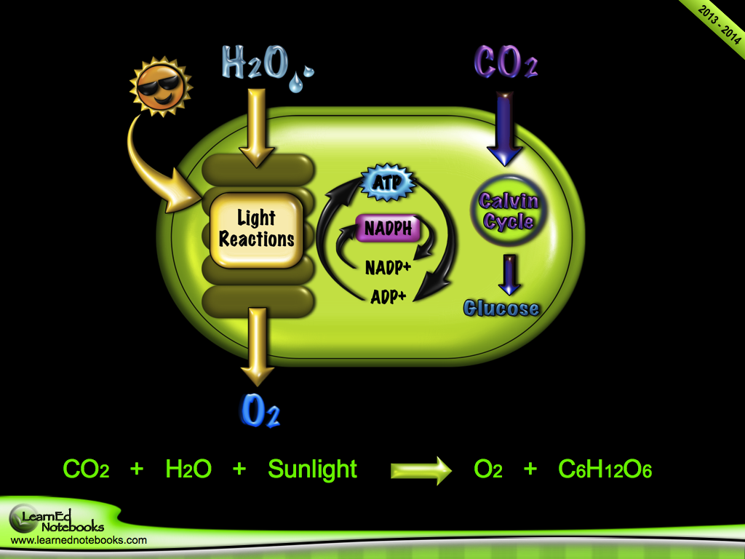

Slide 9
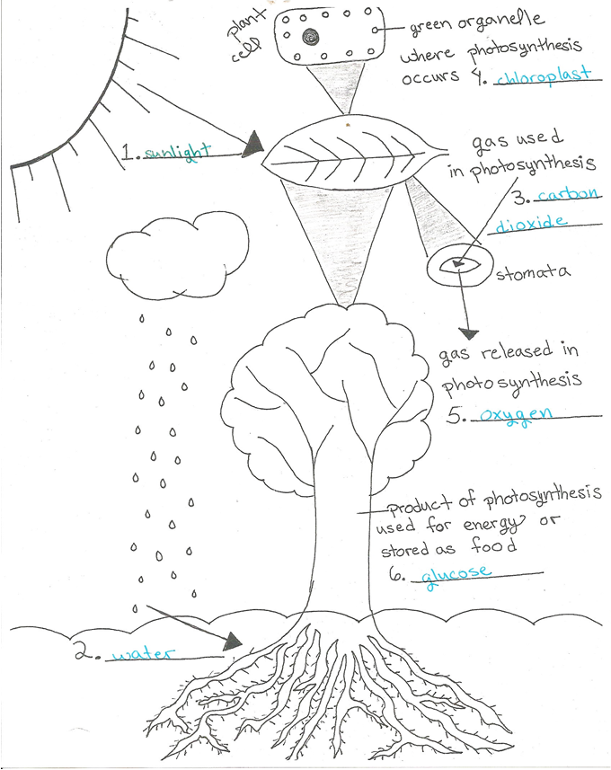
Bioenergy Flow Chart Photosynthesis – Activity
Draw and label a visual flow chart that uses the terms to your right to describe the steps of photosynthesis from start to finish AND COLOR.
Light Energy
Chloroplast
Chlorophyll
Enzymes
Carbon Dioxide
Water
Glucose
Oxygen Gas
Hydrogen
Light Dependent Reactions
Calvin Cycle (Light Independent Reaction)
Thylakoids
Stroma
ATP
ADP
NADP
NADPH

Slide 10
Photosynthesis and Elodea Lab - Handout

Slide 11
Cellular Respiration

Slide 12
Cellular Respiration
Cellular respiration: the process by which cells produce energy by breaking down glucose
Where does the energy come from?
When glucose (C₆H₁₂O₆) breaks down, the high energy bonds break and are used to make ATP

Slide 13
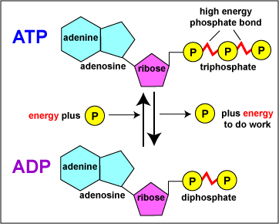
What is this ATP, and why should I care?
ADP can be recycled by adding a phosphate to make ATP.
ATP stand for adenosine triphosphate.
A chemical with three phosphate groups attached.
How does the cell gain energy from ATP and ADP?
Cell bonds are broken to produce ADP.

Slide 14
What is this ATP, and why should I care?
Cell uses ATP for energy.
Why does the cell go through the trouble to produce ATP when sugar (Glucose) is stored energy?
Smaller/Easier to transport around the cell.
Easier to access (Not intended for storage.)

Slide 15
Bioenergy Flow Chart - Handout
Complete the flow chart as we cover the content. Make sure you leave room next to your notes on Cellular Respiration so that you may glue in this visual.

Slide 16
Cell Respiration Why?
Done by plants & animals
Taking glucose created by plants and producing energy(ATP) for life
Energy from food is used to convert into Energy(ATP) that cell’s use to carry out life processes.

Slide 19
Location
Glycolysis & Fermentation happen in the Cytoplasm
TCA/ Kreb’s Cycle and Electron Transport Chain occur in the Mitochondria

Slide 20
Steps of Cell Respiration
Glycolysis~2 ATP in cytoplasm
Kreb’s Cycle~2 ATP in mitochondria
Electron Transport Chain~34 ATP in mitochondria
TOTAL: 34-38 ATP

Slide 21
Cellular Respiration
Which gas affects aerobic respiration the most?
Oxygen
What else may affect aerobic respiration?
Amount of glucose available
Which gas may affect photosynthesis the most?
Carbon dioxide
What else may affect photosynthesis?
Light intensity, pH, temperature

Slide 22
Cellular Respiration
Aerobic cellular respiration:
Needs oxygen
Occurs in the mitochondria
Has inner folds called cristae to increase surface area
Allows for more ATP production
Produces 36-38 ATP
Glucose breaks down completely to carbon dioxide and water by several reactions that require oxygen

Slide 23
Cellular Respiration
Anaerobic cellular respiration (fermentation):
Does NOT need oxygen
Occurs in the cytoplasm
Glucose is not broken down completely to carbon dioxide and water
ATP production is not as efficient
Produces ONLY 2 ATP
2 types of fermentation:
Alcoholic fermentation and lactic acid fermentation

Slide 24
Cellular Respiration
Alcoholic fermentation:
Yeast use fermentation to convert glucose to ethyl alcohol
Examples: bread dough and beer and wine

Slide 25
Cellular Respiration
Lactic Acid Fermentation:
Bacteria use fermentation to convert glucose to lactic acid
Examples: sour milk and yogurt
Muscles cells – change from aerobic respiration to fermentation when oxygen levels are low
Glucose breaks down to lactic acid
Have you ever had a muscle cramp?

Slide 26
Bioenergy Flow Chart – Activity
Anaerobic
Aerobic
Lactic Acid Fermentation
Alcoholic Fermentation
Carbon Dioxide
Water
Glucose
Oxygen Gas
Enzymes
ADP
ATP
Mitochondrion
NAD+
NADH
Krebs Cycle
Electron Transport Chain
Draw and label a visual flow chart that uses the terms to your right to describe the steps of cellular respiration from start to finish.

Slide 27
Alcoholic and Lactic Acid Fermentation Lab - Handout
Complete lab and submit assignment.

Slide 28
Cellular Respiration and Photosynthesis Comparison - Handout
Complete the handout.
Raise your hand once you have completed the assignment so that I may check you off.
Once you have been checked off glue the handout into your notebook.

