Slide 1
5.3 DNA Replication

Slide 2
Why? DNA Replication
The DNA molecule’s most crucial task is to provide the information necessary to lead to the production of proteins
Must make EXACT copies!
Why? All cells need the same copy of DNA when they divide
This process is called DNA replication-happens during S phase

Slide 3
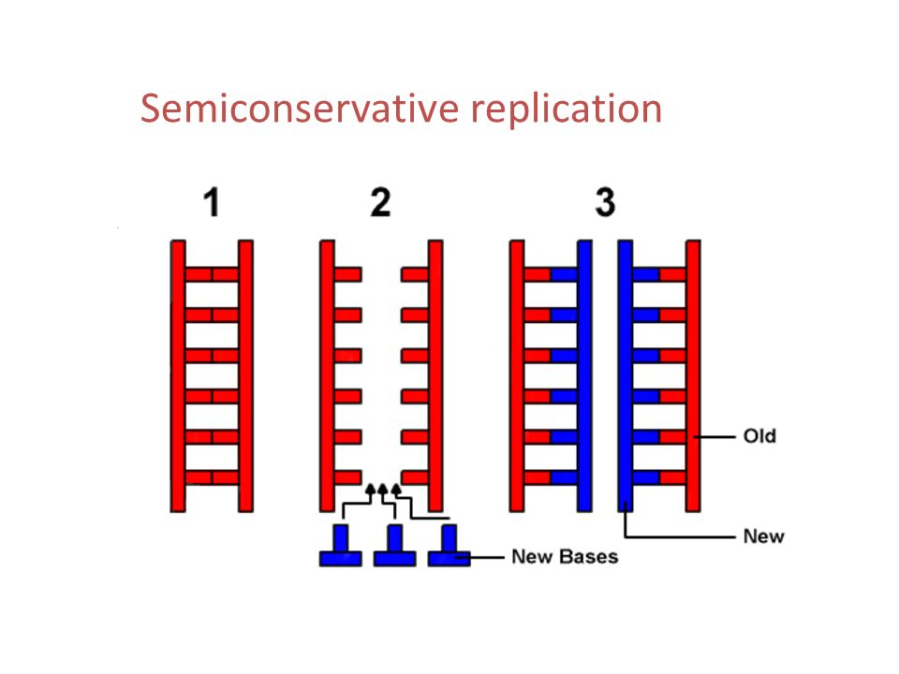
Semi Conservative:
Replication produces two copies of DNA, each that contains one original strand and one new strand

Slide 4
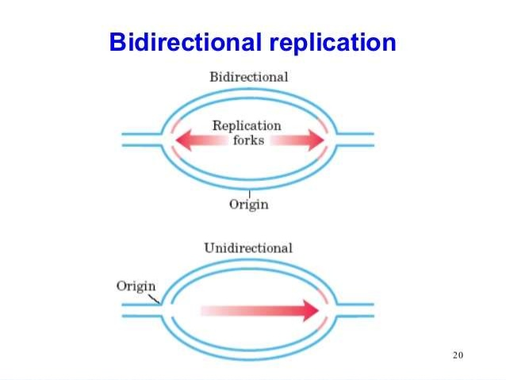
Replication Origins
Can occur directionally or bi-directionally
Creates a replication fork to expose nitrogenous bases
Bi-directionally greatly limits time required for DNA to replicate (faster)

Slide 5
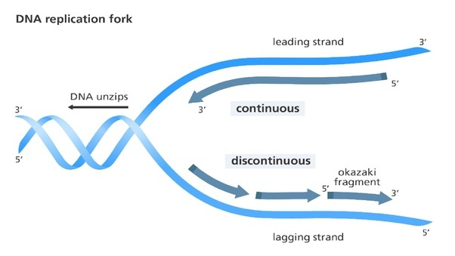
Leading/ Lagging Strands
Leading→ continuous
Replication occurs in one fluid motion
Laggind→ discontinuous
Replication occurs in chunked segments that will later have to be joined up

Slide 6
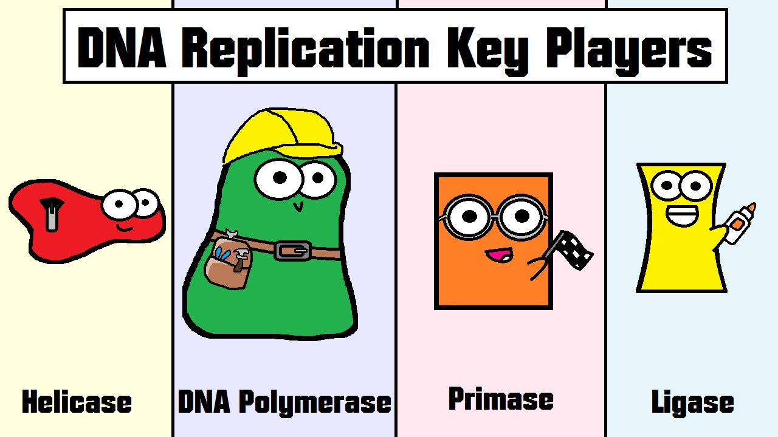
DNA Replication Key Players
Enzymes: DNA replication is carried out by a complex system of enzymes. (4 major ones)
Helicase→ “zipper”
Polymerase→ “builder”
Primase→ “Finish line”
Ligase→ “glue”

Slide 7
Major Enzymes cont.
Helicase: Unwinds (unzips) and separates double strand DNA by breaking hydrogen bonds b/w bases
DNA Polymerase: makes new strands from the original template strands.(adds nucleotides)
Primase: indicates when replication needs to stop
Ligase: joins the original DNA and the new DNA together

Slide 8
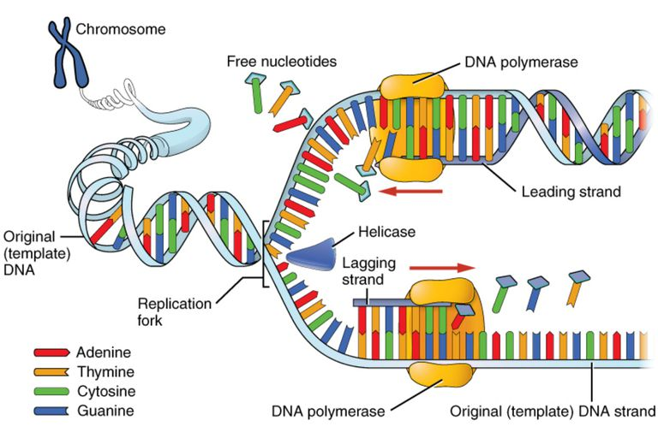
END GAME
At the end of DNA replication there will be 2 exact copies of DNA so that a cell can finish out the cell cycle

Slide 9
DNA Replication Steps/ Overview
Helicase untwists and unzips DNA double helix, exposing single nitrogenous bases.
Free nucleotides will begin to find their complementary bases on the original strand that is now open.
DNA polymerase “builds” or constructs the free nucleotides into a new DNA strand based on the template from the original DNA strand.
Primase will give the signal to end Replication and Ligase will begin gluing the original strand and new strands together → basically forming new H-bonds.

