Slide 1
Protein synthesis

Slide 2
Giant Foldable - activity
Fold your paper so the two ends meet in the middle. Label Transcription on one side and Translation on the other.

Slide 3
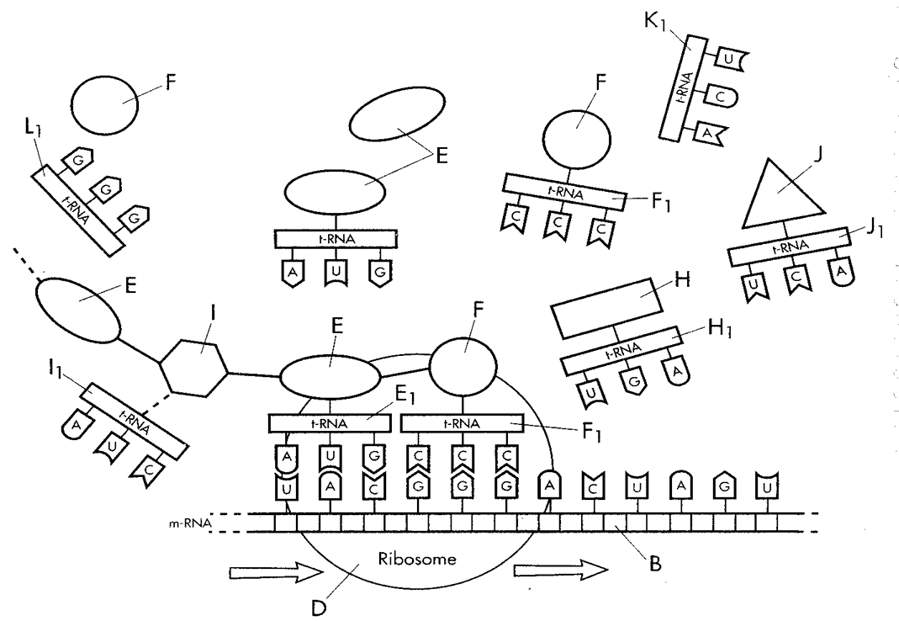
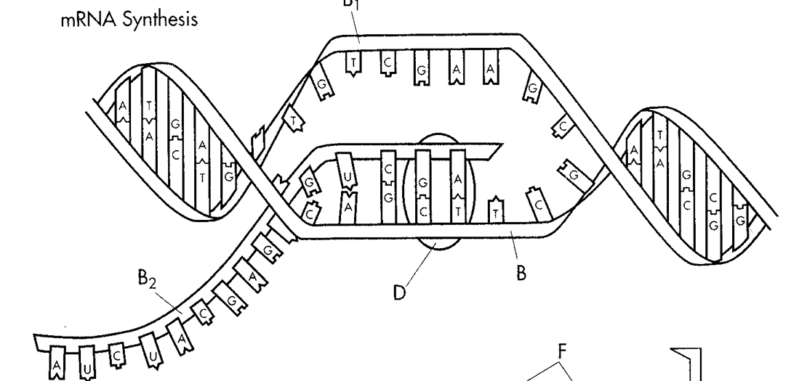
Protein synthesis foldable
Transcription
Translation
What?
Steps of transcription?
Location?
Why?
What?
Steps of Translation?
Location?
Why?
Create a giant foldable that answers the questions below. Draw a picture to represent each part of translation and transcription. Highlight the following terms on your diagram mRNA, tRNA, rRNA, ribosomes, DNA, Nucleus, Cytoplasm, Codon, Anticodon, Protein Synthesis, Amino Acids, Peptide Bonds, Enzymes Relationship to Codons and Anticodons.

Slide 4
Ameoba Sisters

Slide 5
Protein synthesis Analogy - handout

Slide 6
Protein synthesis Discussion
DNA houses all of the genetic information in every cell.
All body cells have same DNA in your body.
Written Response #9: How are genes expressed differently?
Production of proteins

Slide 7
Protein Synthesis
In other words, the reason your skin cells are different from your eye cells:
Every cell has identical DNA, yet it is not always expressed in the same way
Some genes in each cell are expressed, which code for the making of PROTEINS
Written Response #10: How do we get proteins?

Slide 8
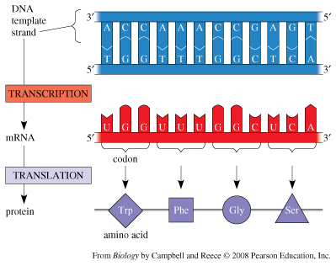
Transcription
STEP ONE (Transcription): Writing and sending the “script”
DNA can’t leave the nucleus so it must produce mRNA, using its base sequence as a template (C still matches with G, but A now matches with U – replaces T).
Occurs in the nucleus (Because DNA can’t leave!)

Slide 9
Transcription – how does it occur?
An enzyme unzips the DNA (located in nucleus)
mRNA is created from the DNA template (Remember to replace T with U)
mRNA leaves the nucleus and goes into the cytoplasm to find a ribosome.
Written Response #11: Write the DNA sequence, then transcribe the DNA into mRNA.
U A G G C U C A A

Slide 10
Transcription
RNA: Ribonucleic acid
Vital for protein synthesis
Single stranded
Still composed of nucleotides like DNA, but each nucleotide contains:
Ribose sugar (5-Carbon)
Phosphate group
Nitrogen base
G, C, A, U (replaces T)

Slide 11
Transcription
3 Forms of RNA:
mRNA (messenger RNA)
Takes message from the DNA in the nucleus to the ribosome (the site of protein synthesis/translation)
rRNA (ribosomal RNA)
Compose ribosomes, decode mRNA
tRNA (transfer RNA)
Responsible for composing anticodons in the production of proteins

Slide 12
Transcription REVIEW
Occurs in the nucleus
Double stranded DNA to single stranded RNA
U replaces T, but still matches with A
mRNA is able to leave the nucleus ribosome in order to being step 2 (translation)

Slide 13
translation
STEP 2 (Translation): “Translating” the script into the language of proteins
Transcription occurs using original DNA in the nucleus. The mRNA then leaves the nucleus and travels to the ribosome, where translation decodes the 3-base codons into amino acids and assembles them into proteins

Slide 14
translation
Once the mRNA is made from the original DNA, it leaves the nucleus in order to begin translation
AKA: protein synthesis
Must travel to the ribosome
Located within the cytoplasm

Slide 15
Translation
mRNA leaves the nucleus
mRNA lands on a ribosome
The ribosome “reads” the mRNA by using codons
Codon: 3 RNA nucleotides that code for an amino acid
Each codon codes for a different amino acid
The amino acids are brought to the ribosome by tRNA. In order for the amino acid to be left at the ribosome, the anticodon must match with a mRNA codon.
Materials for each amino acid are assembled. The amino acid is removed by an enzyme.
Amino acids link up to form proteins
Use peptide bonds = polypeptides

Slide 16
Written Response #12: Write the mRNA sequence and translate to tRNA anticodon
A U C C G A G U U

Slide 17
Translation
Proteins: Have many functions including growth/repair and gene expression
Important Proteins: insulin, hemoglobin, keratin, collagen, etc.
Proteins produced in each cell dictate the type of the cell and how your trait physically appear
Everything in life revolves around PROTEINS
Cells produce different types and amounts of proteins to respond to their environments
Can NOT occur without transcription & translation

Slide 19
Decoding DNA - Handout

Slide 21
Results of protein synthesis
Cells respond to their environments by producing different types and amounts of proteins
The cell produces proteins that are structural (forms part of cell materials) or functional (enzymes and hormones).
All of an organisms cells have the same DNA, but the cells differ on the expression of the genes.
Each individual in a sexually reproducing population has slightly different sequences of nucleotides in DNA when compared to other organisms of the same species. Different sequences lead to different proteins, which produce different traits. Ex: two humans with different eye color.

Slide 22
Protein synthesis
1 codon (3 RNA nucleotides) to make 1 amino acid
Some amino acids can be made with multiple codons
This means we can make the same proteins even if the proteins get changed a little

Slide 23
Start / initiator codon
Codon that starts an amino acid sequence
Always AUG

Slide 24
Stop Codon
Ends the sequence of amino acids
UAA
UAG
UGA

Slide 25
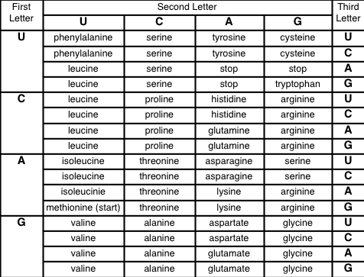
CAG

Slide 26
AUG

Slide 27
GGG

Slide 28
UGA

Slide 29
Protein Synthesis Simulation - Activity

Slide 30
Alien DNA - Activity

Slide 31
Strawberry DNA Isolation lab

