Slide 1
Classification
Classification: the science of grouping organisms into taxonomic groups
Based on similarities among organisms

Slide 2
Classification
Biodiversity: diversity among living species in a particular area
Scientists use classification to organize and classify the millions of organisms that make up Earth’s biodiversity

Slide 3
Classification
Taxonomy: classifying and scientifically naming organisms
Individual groups: taxa (taxon: singular)

Slide 4
Written Response #8: Classification of Shoes
Remove your right shoe. Place it on top of your desk.
Get into a group of four.
Classify the shoes on your table and place them into a flow chart (similar to the one on the right) with “shoes” being the domain.
Continue classifying your shoes until you have identified each shoe to the simplest form.
Shirts
T-Shirt
Dress Shirt
V-Neck
Round Neck
Full Button
Partial Button

Slide 5
Written Response #8, Contd.: Classification of Shoes
New shoe species have been discovered and need to be classified.
Your group of 4 needs to join with 2-3 other groups of 4 to form a group of 12 to 16.
1 member of your large group needs to get a large white board and a dry-erase marker.
Re-classify the shoes in your group (starting with the most broad and become more specific) and draw your classification system on your large white board.
One representative from each group will test the other group’s classification system with their shoe.

Slide 6
Written Response #8, Contd.: Classification of Shoes
What were some of the common characteristics that you used to classify your shoes?
Did you have any trouble classifying them? Explain.
Was it difficult to use your chart for the 3 new shoes? Were there problems you ran into?
How about the last 3 new shoes?
Is there more than one way you could have classified the shoes?
Conclusion: 2-3 sentences on what you learned in this activity.

Slide 7
History of Classification
Aristotle
Divided all organisms into 2 main groups
Plants and animals
They were further subdivided into water, land and air
Linnaeus’ system of classification: expanded on classification to develop the modern system
Established the hierarchy on the next slide

Slide 8
Classification Hierarchy
Kingdom: groups of different phyla
Phylum: groups of different classes
Class: groups of different orders
Order: group of different families
Family: groups of different genera
Genus: groups of different species
Species: most specific category
Can breed and produce fertile offspring
Kingdom
Phylum
Class
Order
Family
Genus
Species

Slide 9
Linnaeus’ Classification System
The modern system also includes domains:
Domain: largest taxonomic group; encompasses all life
3 domains: archaea, bacteria, eukarya
Also developed binomial nomenclature
2 word naming system to group organisms
Still based on characteristics
2 part scientific name; using genus first, followed by species
Italicized (or underlined when written)
Examples: Homo sapies (humans); Quercus alba (white oak); Eublepharus marularius (leopard gecko); Quercus palustris (pin oak)
What do you notice about the white oak and pin oak?
Share the same genus (most closely related)

Slide 10
Binomial Nomenclature Practice
Pick up a half-sheet from the front table.
Using the word bank and key, determine the scientific name of the organisms listed.

Slide 11
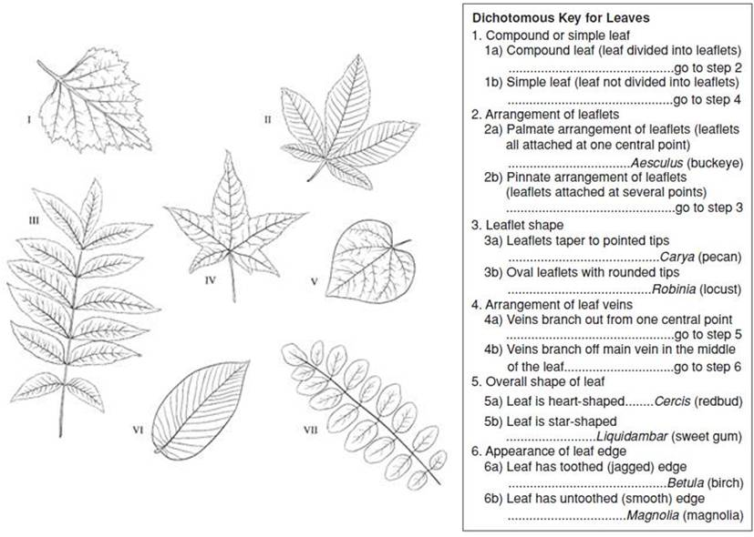
Dichotomous Key: multi-step tool used to identify a species

Slide 12
Classification
Modern taxonomy describes 3 domains:
Archaea: all are prokaryotes
Bacteria: all are prokaryotes
Eukarya: all are eukaryotes
Most diverse domain and includes most of the organisms you are familiar with
Protists, Fungi, Plants and Animals are all classified within the domain of Eukarya

Slide 13
Archaea
Includes only the kingdom, Archebacteria:
Single-celled, prokaryotic bacteria
Anaerobic: can’t tolerate oxygen
Producers, consumers or decomposers and live in extreme conditions

Slide 14
Bacteria
Includes only the kingdom, Eubacteria:
Single-celled, prokaryotic bacteria
“True” bacteria that are autotrophic, heterotrophic or chemotrophic
Eubacteria are found everywhere, even thriving on your skin
Most are harmless, but some may cause harmful infections

Slide 15
Eukarya
Includes the kingdoms: Protista, Fungi, Plantae, and Animalia
Plantae: photosynthetic organisms with cell walls and chloroplasts
Animalia: complex heterotrophic organisms
Protists: eukaryotes that do not fit easily into any other group
Classified as plant-like, animal-like or fungus-like

Slide 16
Protists
Plant-like protists: classified by method of nutrition (photosynthesis)
Examples: algae (Euglenas, golden algae, diatoms, dinoflagellates)
Animal-like protists: classified by method of movement
Examples: protozoa (ciliates, flagellates, amoeboids, sprozoa)
Fungus-like protists: classified by method of nutrition (break down)
Examples: slime molds (water molds, downy mildews, white rust)

Slide 17
Fungi
Heterotrophic organisms that feed on dead matter
Decomposers: break down food
Contain cell walls but no chloroplasts
Reproduce sexually (spores) and asexually (budding)
Some fungi may cause infections or respiratory diseases
Lichen: symbiotic relationship between fungi and algae
Mycorrhizae: symbiotic relationship between fungi and vascular plants (both benefit)

