Slide 1
Adaptations
Organisms have specific adaptations in their environments
In order to accomplish tasks they must have successful traits
Adaptation: beneficial trait that allows an organism to be best suited for survival

Slide 2
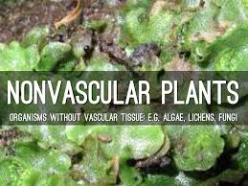
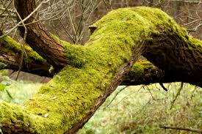
Plant Adaptations
All plants contain cell walls and chloroplasts
Non-vascular plants:
Lack tissues necessary to conduct water and sugars throughout the plant
Must absorb nutrients directly thorough cell walls
Includes: Bryophytes (mosses)

Slide 3
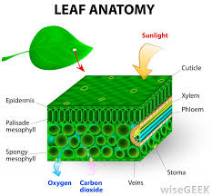
Plant Adaptations
Vascular plants:
Contain the vascular tissues xylem (transports water) and phloem (transports sugar)
Roots (cells undergo mitosis quickly in the roots)
Leaves (photosynthesis occurs in the chloroplasts of leaves)
Cuticle (waxy covering to retain moisture)

Slide 4
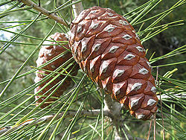
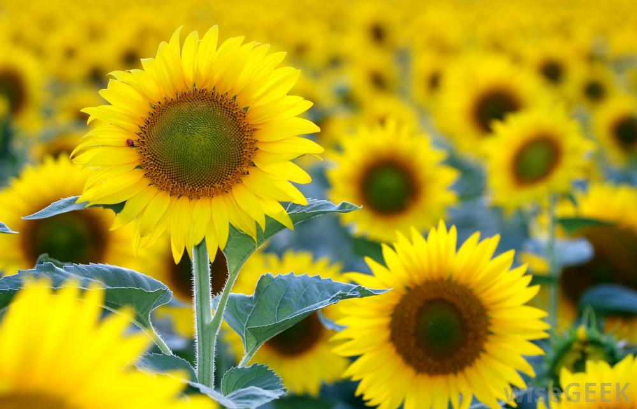
Plant Adaptations
Gymnosperms: produce cones for reproduction
Angiosperms: produce flowers with seeds contained in ovary

Slide 5
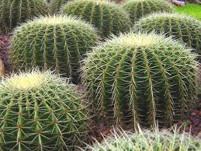
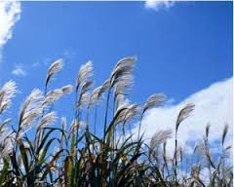
Structural Plant Adaptations
Protection: helps a plant stay safe from predators
Spines and thorns
Textural adaptations
Chemicals or poisons
Reproduction: helps the plant spread genetic information
Hitchhikers
Wind or bird dispersal
Bright colors to attract insects

Slide 6
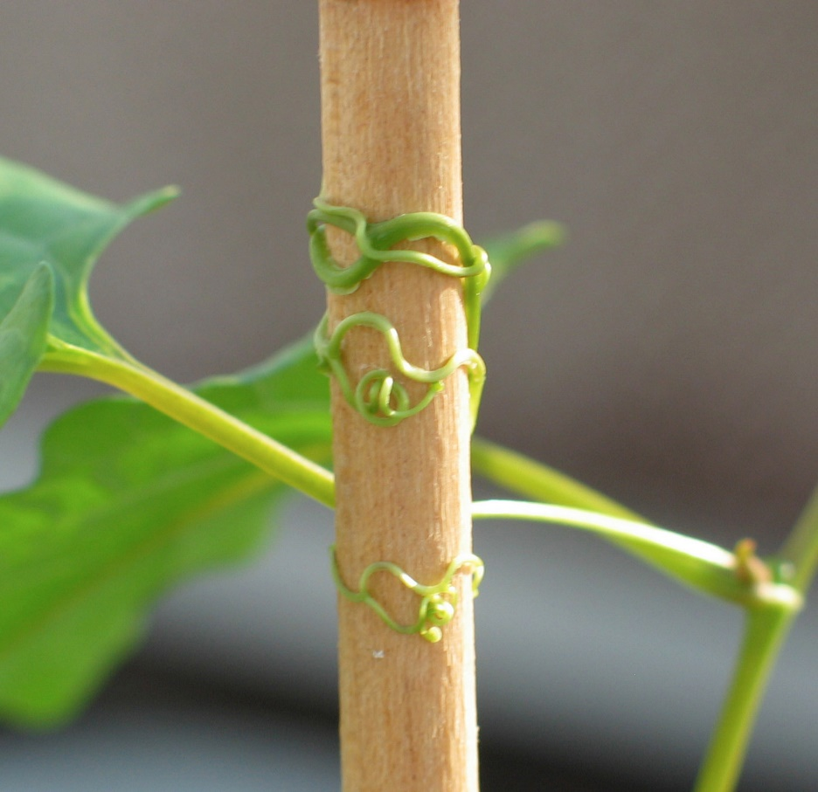
Structural Plant Adaptations
Nutrition: mechanism for acquiring nutrients
Large leaves
Tropisms: movement/growth in response to a stimulus
Phototropism: toward light
Gravitropism: stems grow against gravity
Thigmotropism: response to touch (twisting vines)
Carnivorous plants

Slide 7
Amoeba Sisters – Plant Structure and Adaptations

Slide 8
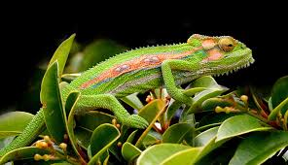
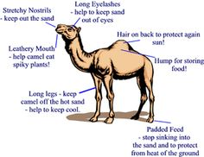
Animal Adaptions
Physical adaptations: help animals survive and thrive
Limited need for water in dry area
Spines to protect from prey
Thick fur in cold climate
Camouflage or mimicry

Slide 9
Slow Loris Video
Slow Loris Eating Banana Video
Cuttlefish Video

Slide 10
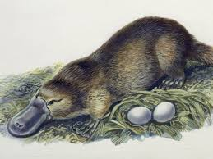
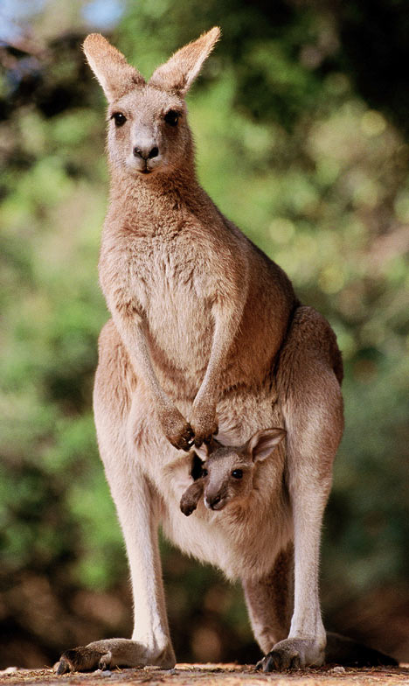
Mammals
Vertebrates: have had (at some point in their lives) an endoskeleton, vertebrae and gill slits
Egg-laying: platypus
Marsupial: offspring complete development in marsupium “pouch”
Placental: provide nourishment to offspring in placenta

Slide 11
Adaptations Summary
Function | Method
Transport | Transferring necessary materials to cells Maintaining pH with buffers, maintaining salt and water balances Plants have xylem and phloem to conduct materials
Excretion | Sending waste to excretory organs Eliminate toxins from cells and bodies
Respiration | Many animals take in oxygen and put out carbon dioxide Plants take in carbon dioxide through leaf pores and put out oxygen
Movement | Many organisms use movement to find nutrients or protection from prey
Nutrition | Autotrophs make their own food (producers) Heterotrophs must acquire food from elsewhere Decomposers break down and absorb their food (fungi)
Reproduction | All organisms are produced from parent(s) and grow and develop Sexual: sperm fertilizes egg to make a new organism, seeds and spores are fertilized embryos, complex mammals nourish with placenta

Slide 12
Innate Behavior
Inborn (genetically programmed), so the organism is born already “knowing” the behavior
Simple innate behaviors
Automatic: quick, unconscious reactions
Examples: reflexes such as blinking
Fight-or-flight: the body prepares for action in response to stress or fear
Examples: increased heart rate when in a car accident

Slide 13
Innate Behavior
Complex innate behaviors: “instincts”
Courtship behaviors: pre-mating behavior designed to help an organism recognize and pick the “best” mate
Example: fireflies flashing lights
Territoriality: defending physical space against other animals; reduces competition
Example: a cat scent – marks it territory to warn others
Aggression: a threatening behavior that one animal uses to gain control over another
Example: lions showing their fangs and snap at other lions
Dominance hierarchy: a social ranking within a group that establishes dominant and submissive members
Example: a puppy rolls over and exposes its belly to adult dogs
Orientation behaviors: animals display taxis behaviors – movement toward or away from a stimulus
Phototaxis: movement in response to light
Example: Moths are attracted to light (positive)
Chemotaxis: movement in response to chemicals
Example: Insects are attracted to chemical signals from other insects (positive)

Slide 14
Innate Behavior
Seasonal rhythms: occur at certain times of the year
Migration: movement form one place to another and back again in response to environmental stimulus
Hibernation: a decrease in metabolism in response to colder temperatures
Estivation: a decrease in metabolism in response to warmer temperatures

Slide 15
Learned Behavior
Acquired during an organism’s life and may change with practice and experience.
Habituation: occurs when an animal is repeatedly given a stimulus with no punishment or reward; eventually the animal stops responding
Example: a human is able to sleep through the night even though they live close to train tracks
Classical conditioning: occurs when an animal makes a connection between a stimulus and some kind of reward or punishment; “learning by association”
Example: Pavlov’s dog
Operant conditioning: occurs when an animal learns to behave a certain way through repeated practice, in order to receive a reward or avoid punishment; “trial and error”
Example: a mouse learns how to get through a maze in order to get the food at the end
Insight learning / reasoning: the most complicated form of learning that occurs when an animal applies something it has already learned to a new situation
Example: a pianist is able to play a new piece of music by “ear”

Slide 16
Combining Learned and Innate Behaviors
Social behaviors: courtship, territoriality, dominance hierarchy and communication
When animals interact with members of their own species, they are exhibiting social behaviors.
Some animals may form societies – a group of related animals of the same species that interact closely and often to cooperate with each other.
Imprinting: involves very young animals recognizing and following the first moving object they see – the urge to follow is innate but must learn from experience what object to follow
Example: ducklings imprint on their mother
Communication: passing of information from one organism to another
Innate forms of communication may involve sound, sight, touch or chemicals
The most complex form of communication is language – the use of symbols to represent ideas; requires a complex nervous system, memory and insight.

Slide 17
Who is the Smartest Mammal?
You will need a partner.
You will each need a worksheet to complete.
Follow the directions outlined on the first page of the worksheet.

